Slide 1
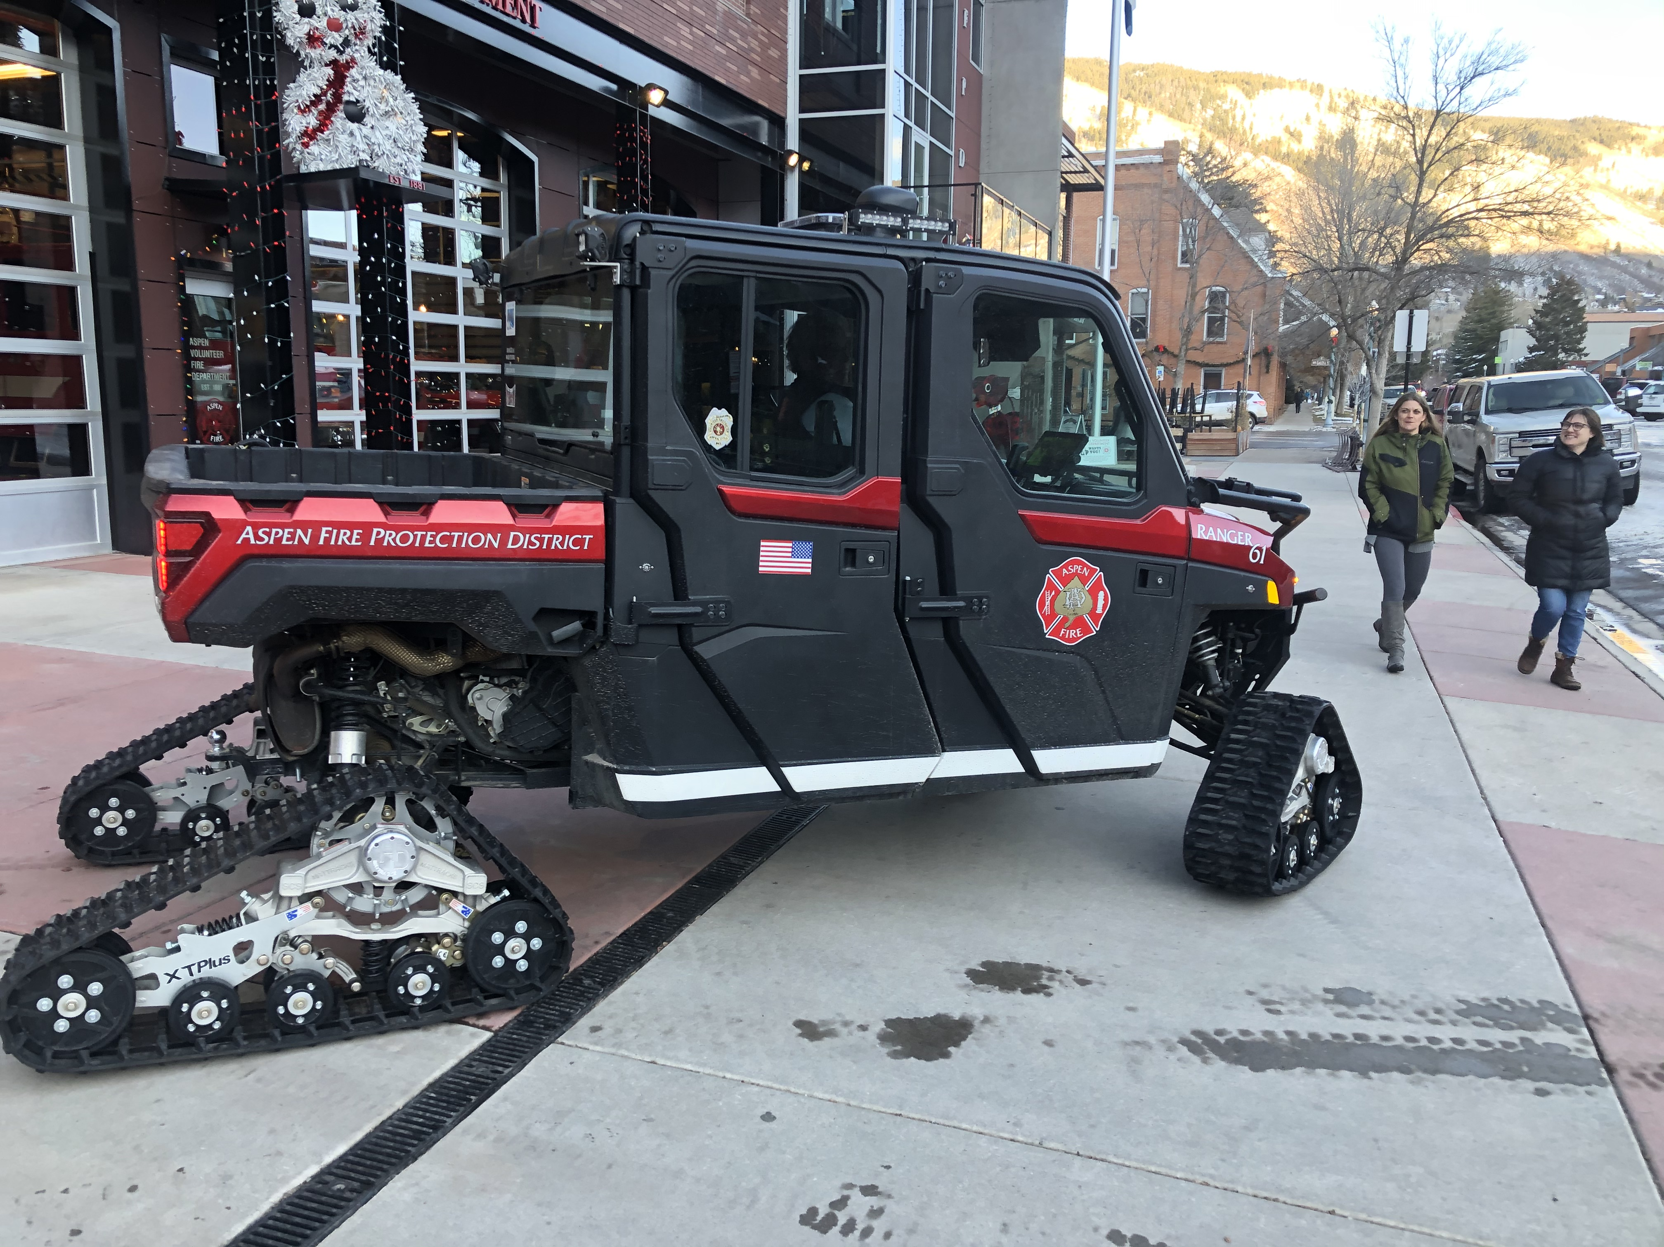
Aspen Fire Protection District
Strategic Planning Workshop

Slide 2
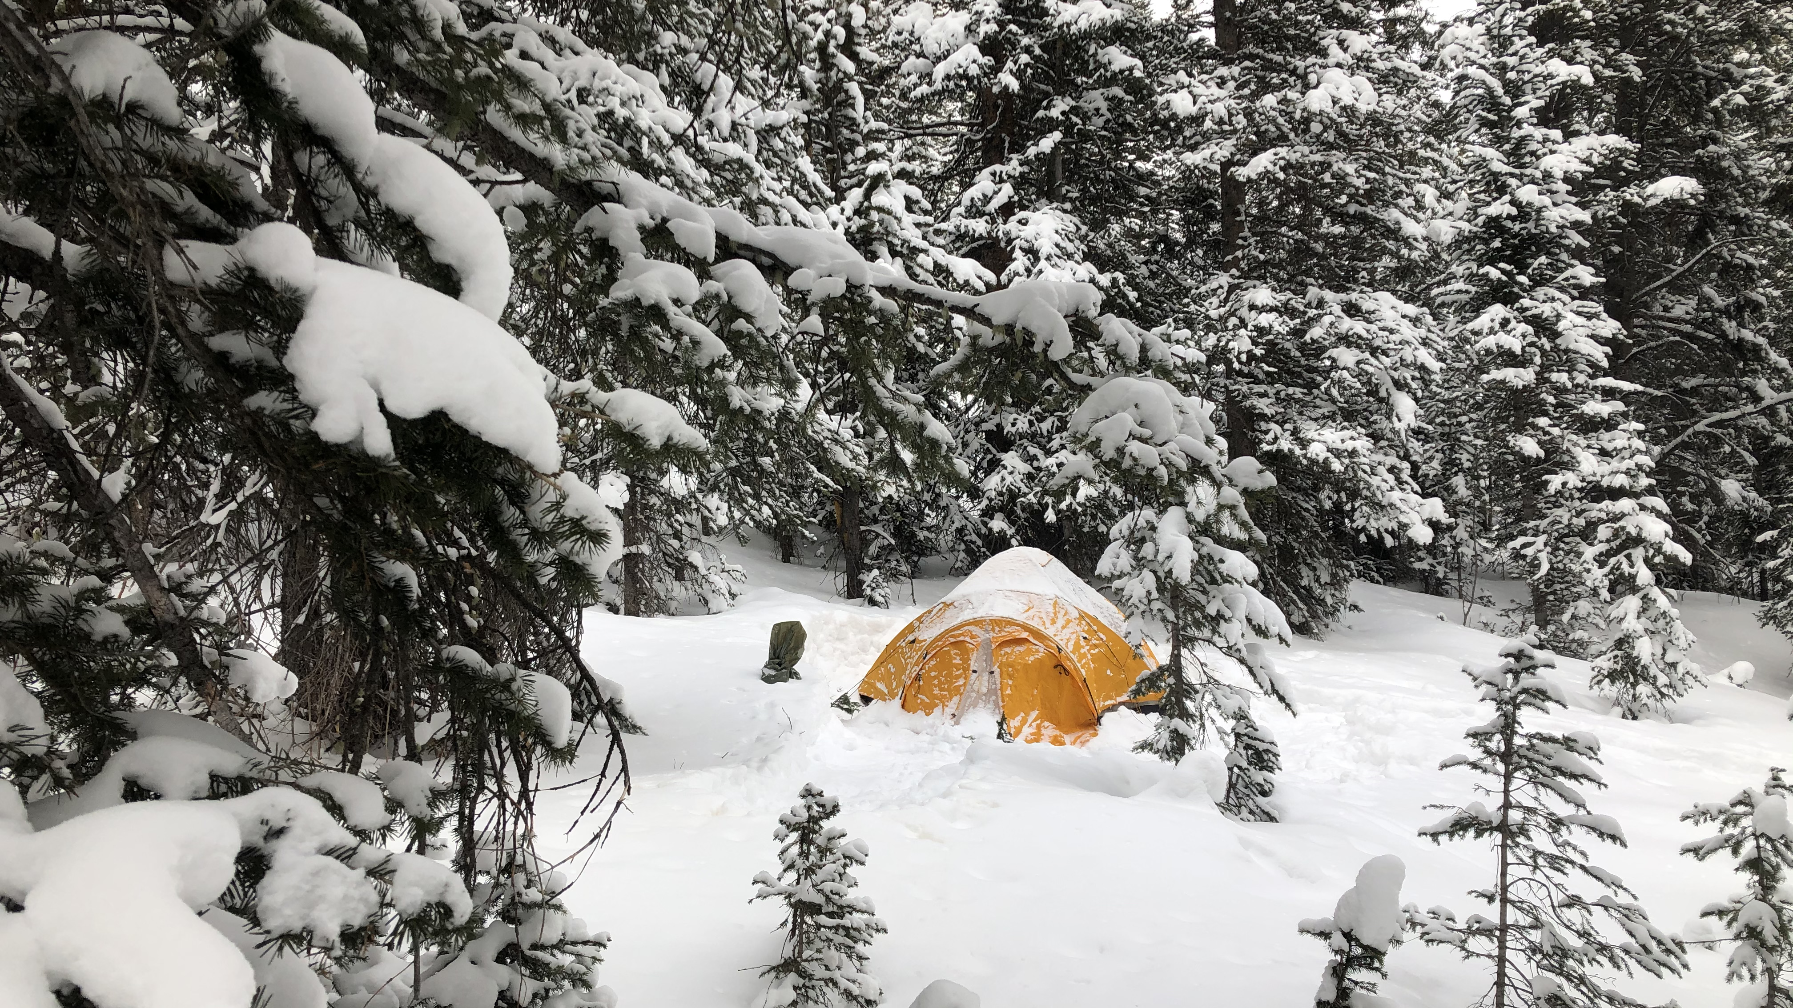
Introductions

Slide 3
Strategic Planning Process
The Aspen Fire Protection District is in the process of developing a strategic plan to guide its efforts for the next five years.
  Started in September 2019
  Organizational Assessment February 2020
    Numerous changes have been initiated
  Strategic Planning began November 2020

Slide 4
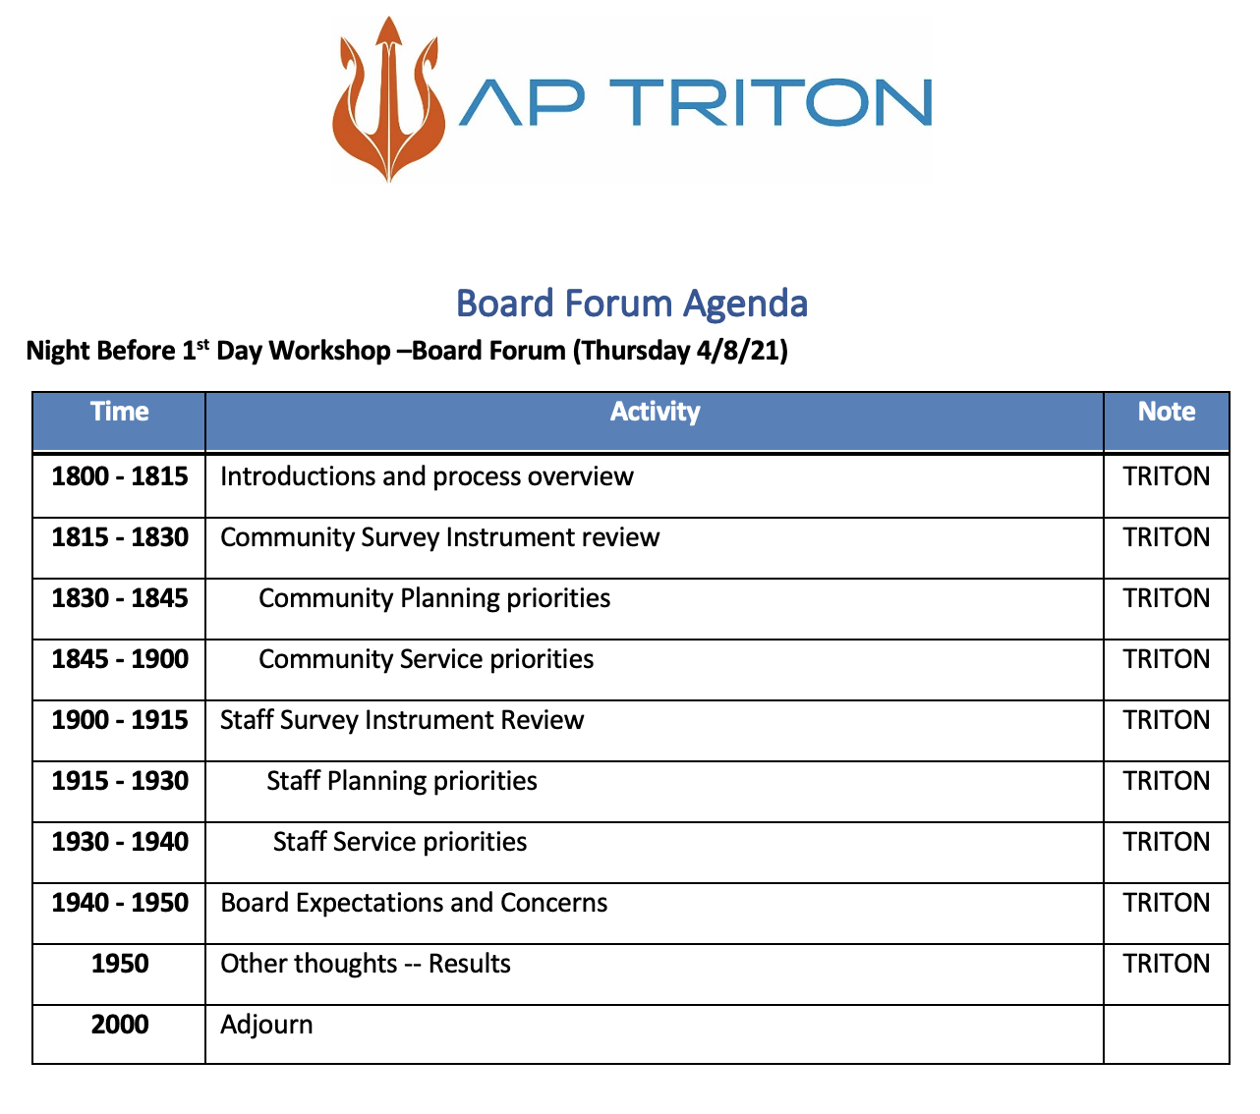

Slide 5
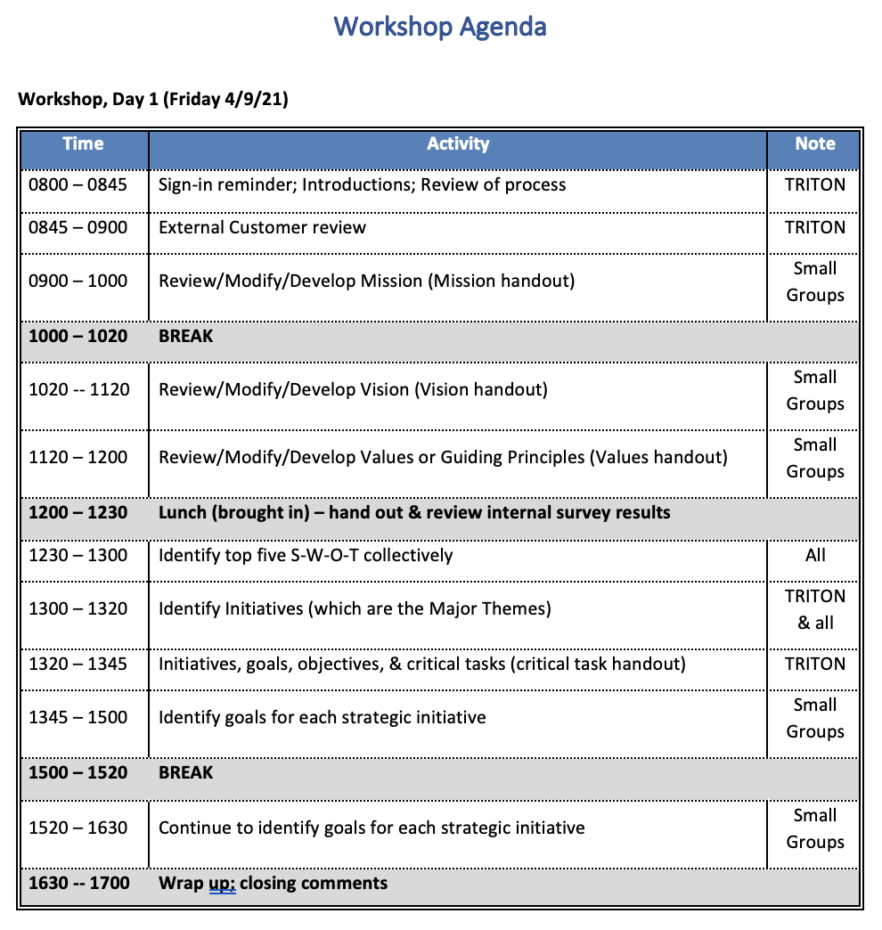

Slide 6
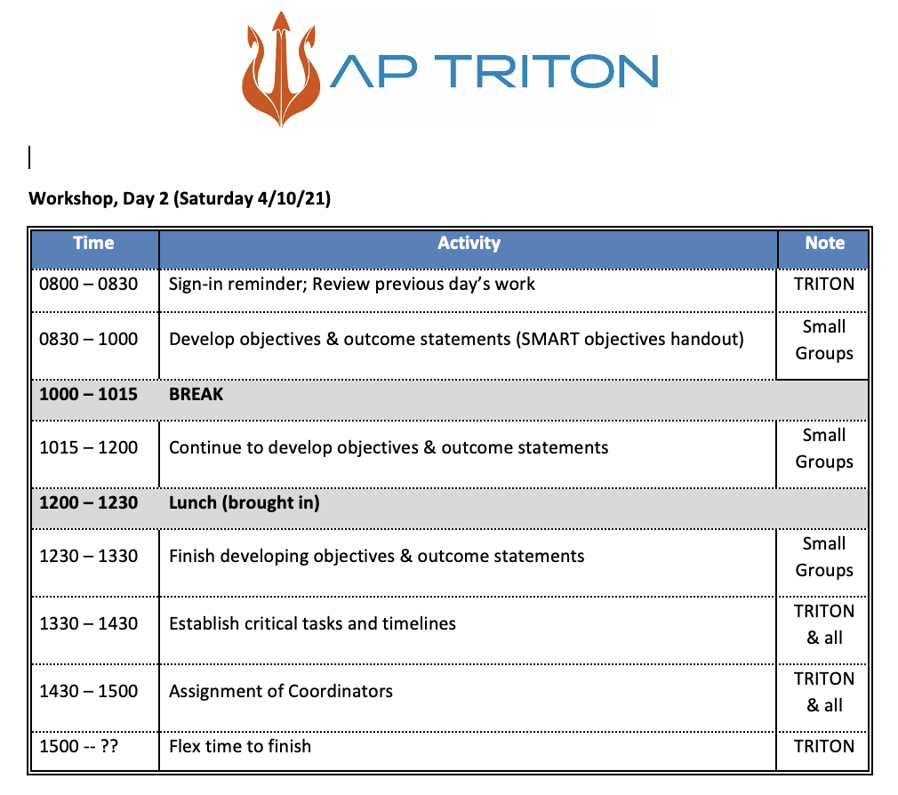

Slide 7
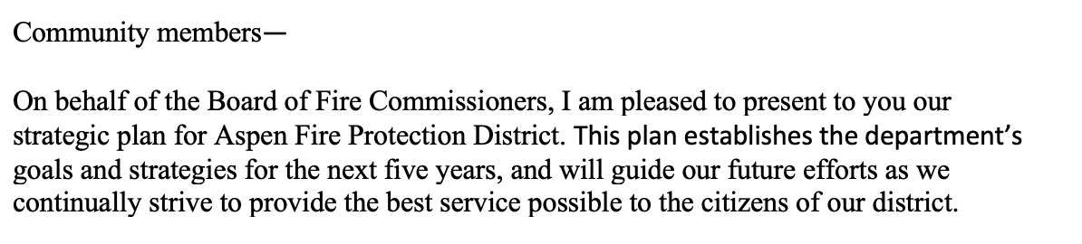

Slide 8
Community Survey

Slide 9
Community
Survey Results – Community Utilization of Services

Slide 10
Community
Survey Results- Customer Satisfaction

Slide 11
Community
Survey Results - Priorities

Slide 12
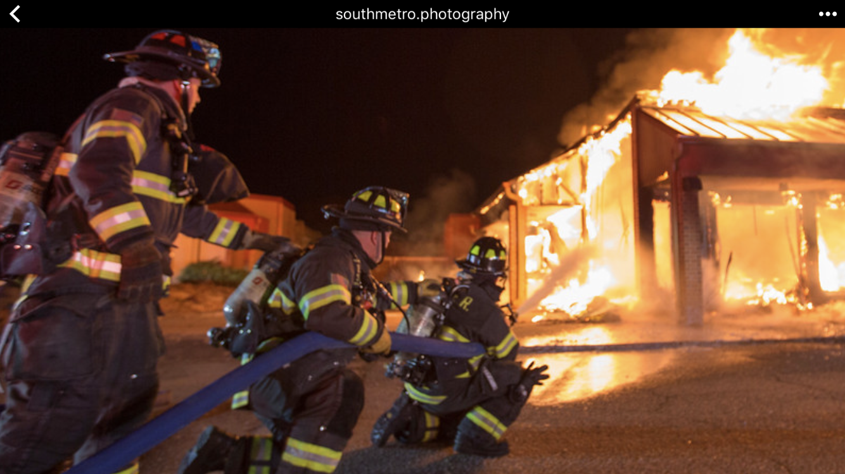
Community Priorities
Survey Results - ”Highly Trained Staff”

Slide 13
Community Priorities
Survey Results - ”Rapid Response”

Slide 14
Community Priorities
Survey Results – “Rapid Response”

Slide 15
Community Priorities
Survey Results – Public Education / Community Interaction
Community Interaction / Public Education
More community events....could the fire department host a car wash for charity where the cars get blasted clean with a fire hose? Or more street parties (with beer!) like the Fourth of July celebrations (but with beer!).
Any fire safety programming in the schools is good. I recall things I learned from interaction with firemen as a student.
Publicize your museum
Add community wildfire safety seminars/webinars on how homeowners can make their property and their neighborhood much safer from wildfires.
Would love a community course on how to handle household fires (example, what do I do if I don't have an extinguisher depending on what is burning? ) I would take CPR classes if they were free
None at this time. I don't know where this fits in: the community outreach programs are great.

Slide 16
Community Priorities
Survey Results - Staffing
Fire Department Staffing
Paid fire and emt's . more free cpr classes for residents
Love the volunteer model. I saw there is now paid fireman and can't really see the need for this
Term limits for the chief, diversify responsibility for management between the volunteers and paid staff, require district board to be more involved.
Paid personal are not needed and a waste of our tax dollars, same with housing.
I think you are doing a GREAT job under the fine leadership of Rick Balentine. We are lucky to have him!

Slide 17
Community Priorities
Survey Results – Wildland Mitigation
Wildland Fire / Mitigation
Wildfire mitigation programs are essential.
Wildfire mitigation awareness, education, prevention and response in view of increases of wildfires and climate change.
With a focus on fighting fires and wildfire mitigation if they need to reduce other components I would support that.

Slide 18
Community Priorities
Survey Results – Emergency Medical Services / Enhance / Consolidate
Enhance or Consolidate EMS
Why is there an ambulance district that has not joined the modern times and made themselves a title 32 district? Why has the fire department allowed this to continue?
Combine with the ambulance service.
Medical services
Well, Aspen Fire is the closest agency to most of the Aspen Ambulance district calls. If my loved one needs medical help why is the Ambulance driving in from the hospital when we are next door to the fire station
More EMT 2 service level to compliment the paramedics. I would like to paramedics to have access to a lucas device
EMS
Better integration of EMS and fire with reducing duplication of services
Consolidate
Work towards continuity with the ambulance district and RFFR, while maintaining independence from these organizations and Pitkin County.
Get over the politics and sit down and merge forces.

Slide 19
Community Priorities (Initiative)
Ensure the technical competence of all personnel (Training)
Improve fire department response time to emergencies
Equipment and facilities are reliable & well maintained
Contain costs to the taxpayers
Interagency Cooperation ( Emergency Medical Response)
Improve Major Incident Response (Community Education and Outreach Wildland Fire)

Slide 20
Member Survey

Slide 21
Members Priorities
Survey Results – Fiscal Responsibility

Slide 22
Members Priorities
Survey Results – Adequately Equipped

Slide 23
Members Priorities
Survey Results – Potential Increased Service Delivery

Slide 24
Members Priorities
Survey Results – Potential Initiatives

Slide 25
Members Priorities
Survey Results – Fiscal Responsibility

Slide 26
Initiative Combined
Community Initiatives
  Training (Professionalism)
  Response Time
  Adequate Resources
  Fiscal Responsibility
  Interagency Cooperation (EMS)
  Major Incident Preparation
Membership Initiatives
  Leadership
  Officer Development
  Communication
  Board Initiatives
  Staffing
  Planning
  Training

Slide 27
Mission, Vision Values

Slide 28
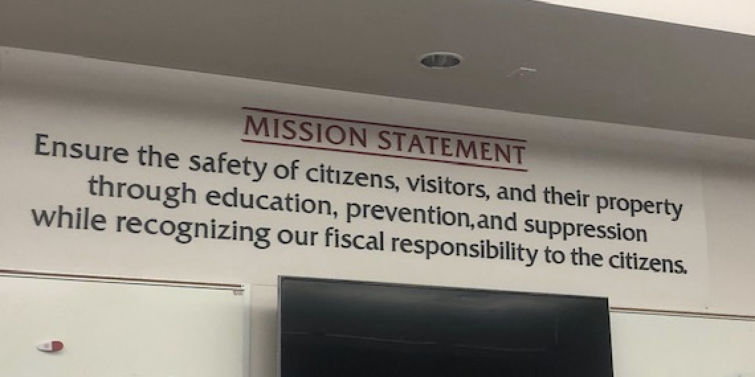
Mission

Slide 29
Vision
Continually exceed our customers’ expectations.
A workforce which reflects the diversity of the community.
A healthy and safe working environment.
An innovative environment which enhances the efficient delivery of emergency services.
An organization that anticipates and influences change.
Provides personnel with the necessary skills and. tools for safe and effective job performance.
Regionalization of emergency services.
A management/labor partnership where decisions are made collaboratively.
Financial stability.
Coordinated preparedness for catastrophic events.
Leading resource for community safety education and information.

Slide 30
Values
We respect the customer.
We recognize the importance of balancing individual, family and organizational growth.
We recognize individual development as an integral part of professional, personal, and department growth.
We believe in treating internal and external customers at least as well as we want to be treated ourselves.
We are open and receptive to new and innovative means of conducting business.
We value honesty and integrity with open communication at all levels.
We value and promote teamwork.

Slide 31
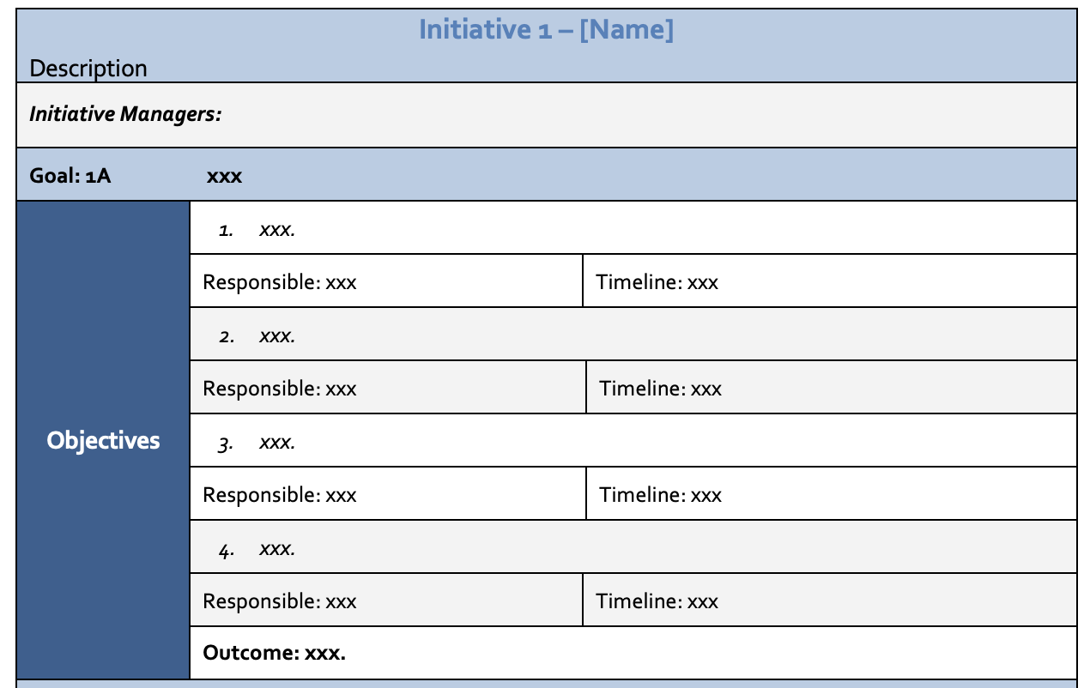
Development of Initiatives

Slide 32

Strategic Plan

Slide 33
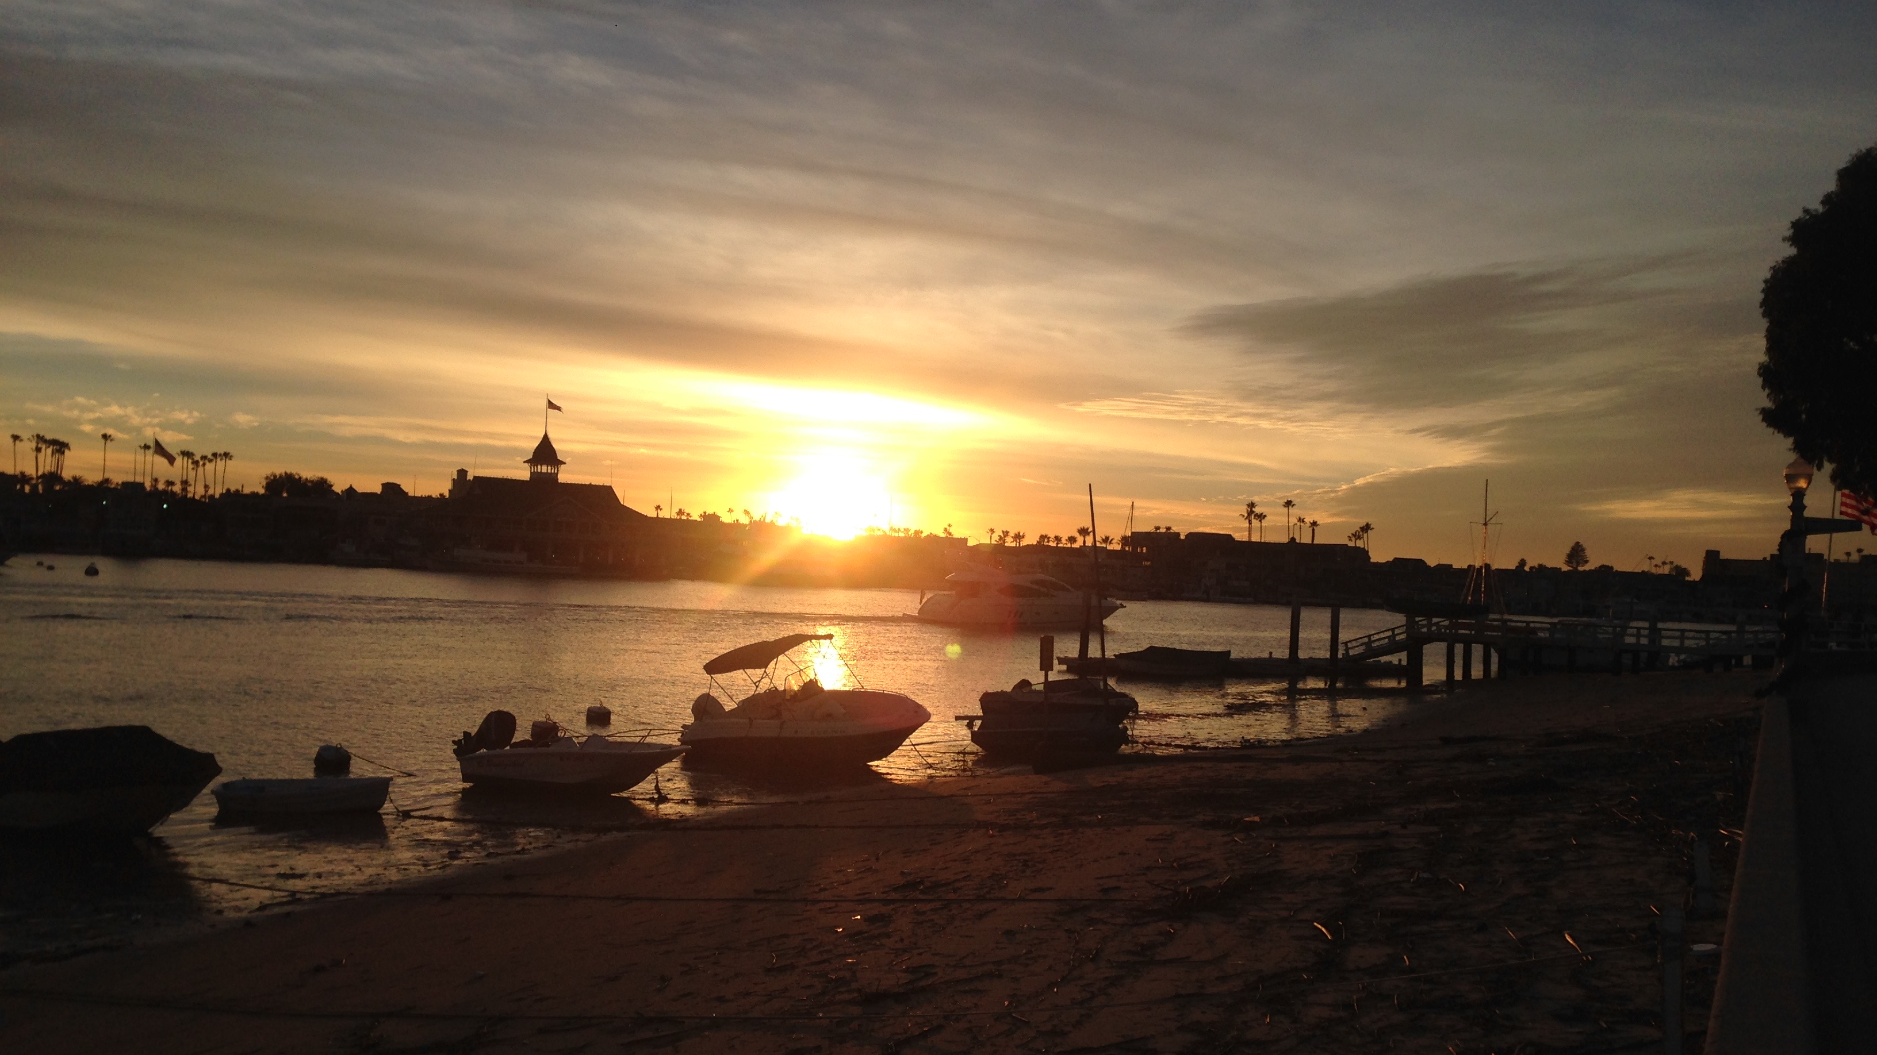
Closing Thoughts

Slide 34
Strategic Planning Workshop
Day 1

Slide 35
Time | Activity | Note
0800 – 0845 | Sign-in reminder; Introductions; Review of process | Buchanan
0845 – 0900 | External Customer review | Buchanan
0900 – 1000 | Review/Modify/Develop Mission (Mission handout) | Hall / Small Groups
1000 – 1020 | BREAK
1020 -- 1120 | Review/Modify/Develop Vision (Vision handout) | Hall / Small Groups
1120 – 1200 | Review/Modify/Develop Values or Guiding Principles (Values handout) | Hall / Small Groups
1200 – 1230 | Lunch (brought in) – hand out & review internal survey results
1230 – 1300 | Identify top five S-W-O-T collectively | Hall / All
1300 – 1320 | Identify Initiatives (which are the Major Themes) | TRITON & all
1320 – 1345 | Initiatives, goals, objectives, & critical tasks (critical task handout) | Buchanan
1345 – 1500 | Identify goals for each strategic initiative | Buchanan / Small Groups
1500 – 1520 | BREAK
1520 – 1630 | Continue to identify goals for each strategic initiative | Buchanan / Small Groups
1630 -- 1700 | Wrap up; closing comments

Slide 36
Mission, Vision, Values

Slide 37
Mission Statement

Slide 38
Value Statement
Continually exceed our customers’ expectations.
A workforce which reflects the diversity of the community.
A healthy and safe working environment.
An innovative environment which enhances the efficient delivery of emergency services.
An organization that anticipates and influences change.
Provides personnel with the necessary skills and. tools for safe and effective job performance.
Regionalization of emergency services.
A management/labor partnership where decisions are made collaboratively.
Financial stability.
Coordinated preparedness for catastrophic events.
Leading resource for community safety education and information.

Slide 39
Values Statement
We respect the customer.
We recognize the importance of balancing individual, family and organizational growth.
We recognize individual development as an integral part of professional, personal, and department growth.
We believe in treating internal and external customers at least as well as we want to be treated ourselves.
We are open and receptive to new and innovative means of conducting business.
We value honesty and integrity with open communication at all levels.
We value and promote teamwork.

Slide 40
SWAT Analysis

Slide 41
SWAT Analysis
Strengths
1.
2.
3.
4.
5.
6.
7.
8.

Slide 42
SWAT Analysis
Weakness
1.
2.
3.
4.
5.
6.
7.
8.

Slide 43
SWAT Analysis
Opportunities
1.
2.
3.
4.
5.
6.
7.
8.

Slide 44
SWAT Analysis
Threats
1.
2.
3.
4.
5.
6.
7.
8.

Slide 45
Initiatives

Slide 46
Initiative Combined
Community Initiatives
  Training (Professionalism)
  Response Time
  Adequate Resources
  Fiscal Responsibility
  Interagency Cooperation (EMS)
  Major Incident Preparation
Membership Initiatives
  Leadership
  Officer Development
  Communication
  Board Initiatives
  Staffing
  Planning
  Training

Slide 47
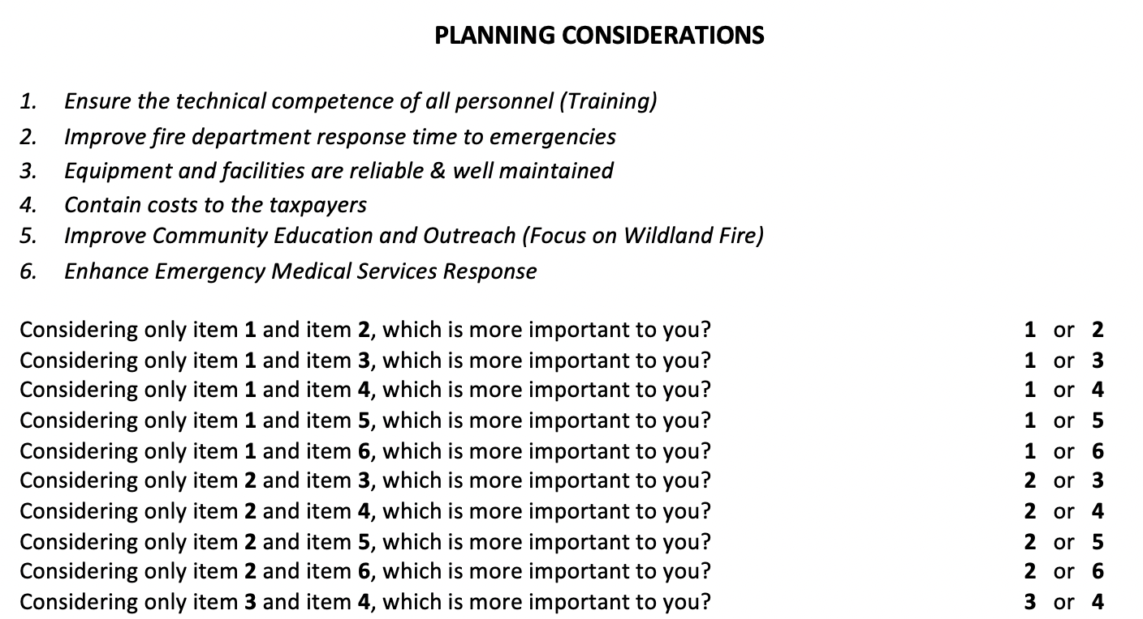
Community Planning Priorities

Slide 48
Initiative X – [Name] Description
Initiative Managers:
Goal: 1A | xxx
Objectives | xxx.
 | Responsible: xxx | Timeline: xxx
 | xxx.
 | Responsible: xxx | Timeline: xxx
 | xxx.
 | Responsible: xxx | Timeline: xxx
 | xxx.
 | Responsible: xxx | Timeline: xxx
 | Outcome: xxx.

Slide 49
Initiative X – [Name] Description
Initiative Managers:
Goal: 1A | xxx
Objectives | xxx.
 | Responsible: xxx | Timeline: xxx
 | xxx.
 | Responsible: xxx | Timeline: xxx
 | xxx.
 | Responsible: xxx | Timeline: xxx
 | xxx.
 | Responsible: xxx | Timeline: xxx
 | Outcome: xxx.

Slide 50
Strategic Planning Workshop
Day 2

Slide 51
Time | Activity |  | Note
0800 – 0830 | Sign-in reminder; Review previous day’s work | Buchanan
0830 – 1000 | Develop objectives & outcome statements (SMART objectives handout) | Hall / Small Groups
1000 – 1015 | BREAK
1015 – 1200 | Continue to develop objectives & outcome statements | Hall / Small Groups
1200 – 1230 | Lunch (brought in)
1230 – 1330 | Finish developing objectives & outcome statements | Hall / Small Groups
1330 – 1430 | Establish critical tasks and timelines | Buchanan & all
1430 – 1500 | Assignment of Coordinators | Buchanan & all
1500 -- ?? | Flex time to finish | TRITON

Slide 52
Initiative X – [Name] Description
Initiative Managers:
Goal: 1A | xxx
Objectives | xxx.
 | Responsible: xxx | Timeline: xxx
 | xxx.
 | Responsible: xxx | Timeline: xxx
 | xxx.
 | Responsible: xxx | Timeline: xxx
 | xxx.
 | Responsible: xxx | Timeline: xxx
 | Outcome: xxx.

Slide 53
Initiative X – [Name] Description
Initiative Managers:
Goal: 1A | xxx
Objectives | xxx.
 | Responsible: xxx | Timeline: xxx
 | xxx.
 | Responsible: xxx | Timeline: xxx
 | xxx.
 | Responsible: xxx | Timeline: xxx
 | xxx.
 | Responsible: xxx | Timeline: xxx
 | Outcome: xxx.

Slide 54
Initiative X – [Name] Description
Initiative Managers:
Goal: 1A | xxx
Objectives | xxx.
 | Responsible: xxx | Timeline: xxx
 | xxx.
 | Responsible: xxx | Timeline: xxx
 | xxx.
 | Responsible: xxx | Timeline: xxx
 | xxx.
 | Responsible: xxx | Timeline: xxx
 | Outcome: xxx.

Slide 55
Initiative X – [Name] Description
Initiative Managers:
Goal: 1A | xxx
Objectives | xxx.
 | Responsible: xxx | Timeline: xxx
 | xxx.
 | Responsible: xxx | Timeline: xxx
 | xxx.
 | Responsible: xxx | Timeline: xxx
 | xxx.
 | Responsible: xxx | Timeline: xxx
 | Outcome: xxx.

Slide 56
Initiative X – [Name] Description
Initiative Managers:
Goal: 1A | xxx
Objectives | xxx.
 | Responsible: xxx | Timeline: xxx
 | xxx.
 | Responsible: xxx | Timeline: xxx
 | xxx.
 | Responsible: xxx | Timeline: xxx
 | xxx.
 | Responsible: xxx | Timeline: xxx
 | Outcome: xxx.

Slide 57
Initiative X – [Name] Description
Initiative Managers:
Goal: 1A | xxx
Objectives | xxx.
 | Responsible: xxx | Timeline: xxx
 | xxx.
 | Responsible: xxx | Timeline: xxx
 | xxx.
 | Responsible: xxx | Timeline: xxx
 | xxx.
 | Responsible: xxx | Timeline: xxx
 | Outcome: xxx.

Slide 58
Initiative X – [Name] Description
Initiative Managers:
Goal: 1A | xxx
Objectives | xxx.
 | Responsible: xxx | Timeline: xxx
 | xxx.
 | Responsible: xxx | Timeline: xxx
 | xxx.
 | Responsible: xxx | Timeline: xxx
 | xxx.
 | Responsible: xxx | Timeline: xxx
 | Outcome: xxx.

Slide 59
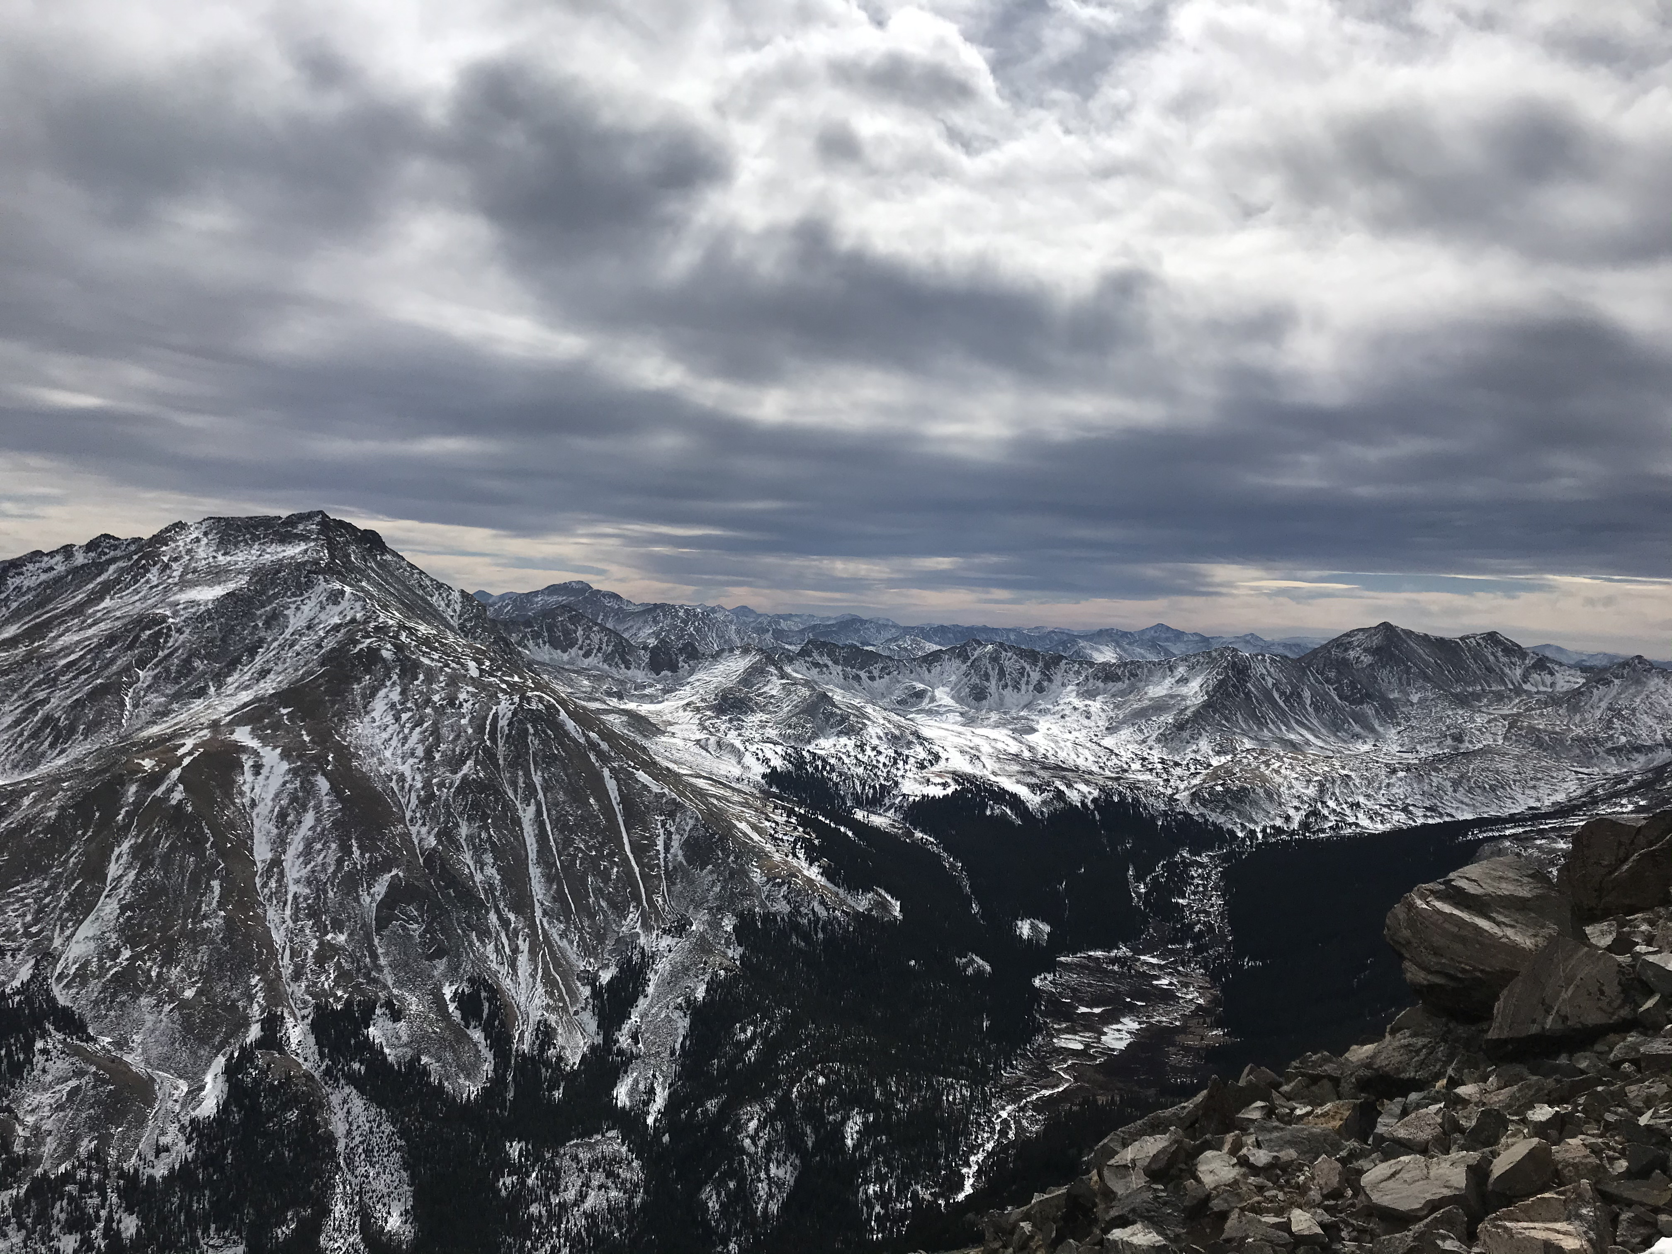
Conclusion

